Slide 1

WAN简介

Slide 2
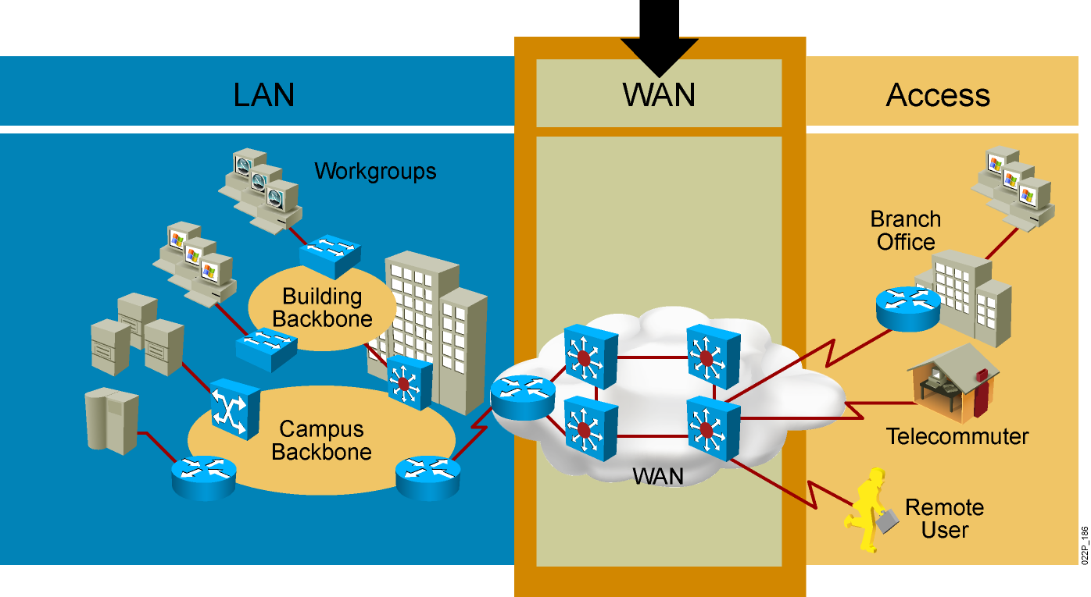
WAN简介
为什么需要 WAN？
分区或分支机构的员工需要与总部通信并共享数据。
组织经常需要与其它组织远距离共享信息。
经常出差的员工需要访问公司网络信息。
Notes:
将远程LAN互联的技术，出口可以使用私有网络的ip地址

Slide 3
WAN简介
广域网链路类型
  专线
  电路交换
  分组交换
  VPN

Slide 4


WAN简介
广域网链路类型
  专线 如T1、T3等
    专有逻辑链接一直在线（安全、高传输质量）
    支持多种物理介质与物理接口标准
    稳定可靠，配置与维护简单
    适合长时间的业务流量需求；价格相对较高
二级行汇聚点
运营商网络
网点路由器

Slide 5
WAN简介
广域网链路类型
  分组交换（包交换）
    允许和其他公司共享带宽。适合突发性数据比较多的。
    分组交换网络可以为特定的端到端连接建立通过交换的路由
    PVC 永久虚电路 在交换开始时就已经建立了路由
    SVC 交换虚电路 根据需要建立
    如x.25、FrameRelay
Notes:
第三种广域网技术就是包交换，耗资巨大，但是成本收不回来，很快就OUT了。很快又提出了一种新的概念，帧中继frame-relay。

Slide 6
WAN简介
广域网链路类型
  电话交换
    定义：由SP为企业远程网络节点间通信提供的临时数据传输通道，其操作特性类似电话拨号技术。常见的如ISDN，ADSL
    性能特点：
      逻辑连接持久有效，按需拨号
      传输介质主要为电话线，也可以为光纤
      带宽主要为56Kbps，64Kbps，128Kbps，2Mbps
      稳定性较差，配置与维护较复杂

Slide 7
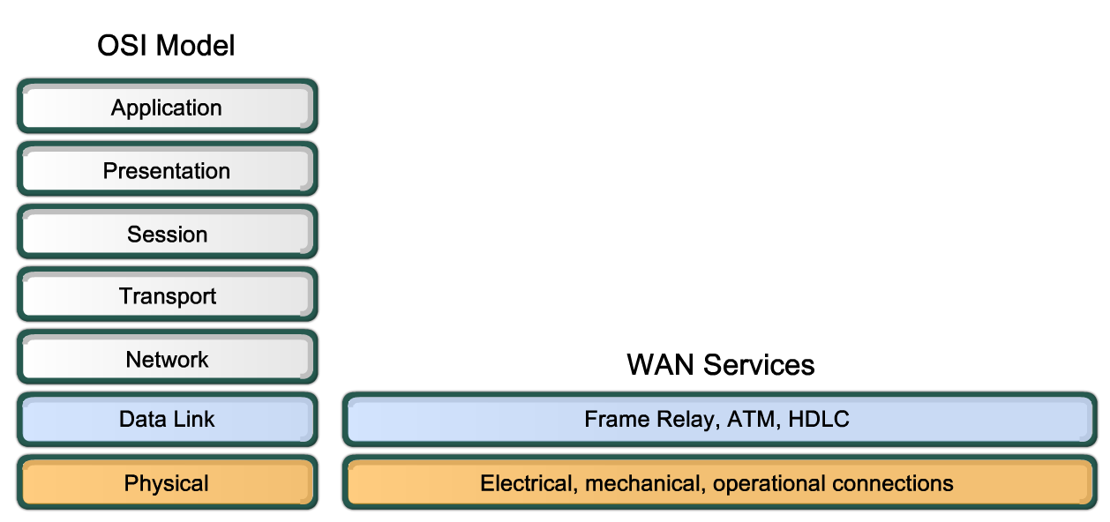
WAN 技术概述
WAN 操作主要集中在第 1 层和第 2 层上。
物理层（OSI 第 1 层）协议描述连接通信服务提供商提供的服务所需的电气、机械、操作和功能特性。
数据链路层（OSI 第 2 层）协议定义如何封装传向远程位置的数据以及最终数据帧的传输机制。

Slide 8
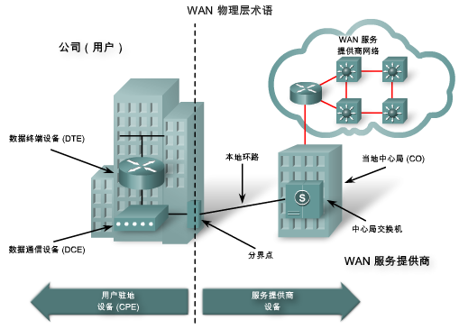
WAN 物理层概念

Slide 9
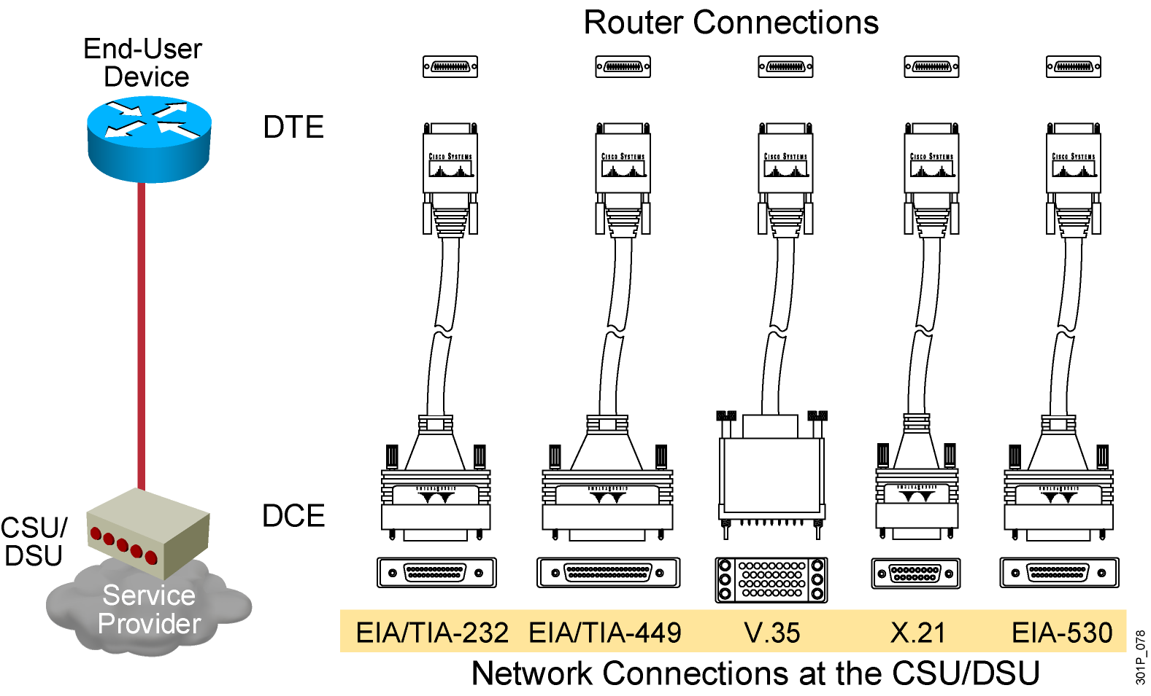
WAN 物理层概念
WAN 物理层协议描述连接 WAN 服务所需的电气、机械、操作和功能特性。WAN 物理层还描述 DTE 和 DCE 之间的接口。

Slide 10
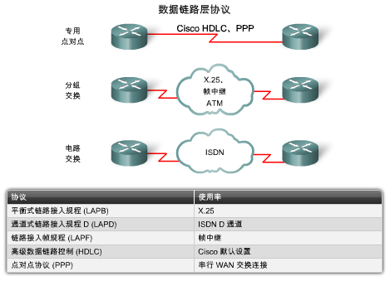
WAN 数据链路层概念
Notes:
数据链路层会根据网络层数据构造数据帧，以便可以对数据进行必要的校验和控制。
所有 WAN连接都使用第 2 层协议对在 WAN 链路上传输的数据包进行封装。
为确保使用正确的封装协议，必须为每个路由器的串行接口配置所用的第 2 层封装类型。
封装协议的选择取决于 WAN技术和设备。

Slide 11
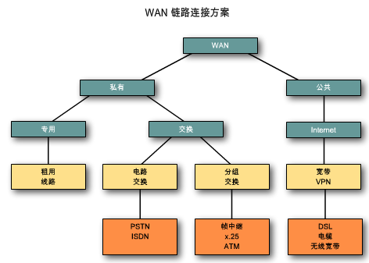
WAN链路解决方案
WAN 解决方案的实施有许多方案。各种方案之间存在技术、速度和成本方面的差异。
WAN 连接可以构建在私有基础架构之上，也可以构建在公共基础架构（例如 Internet）之上。

Slide 12
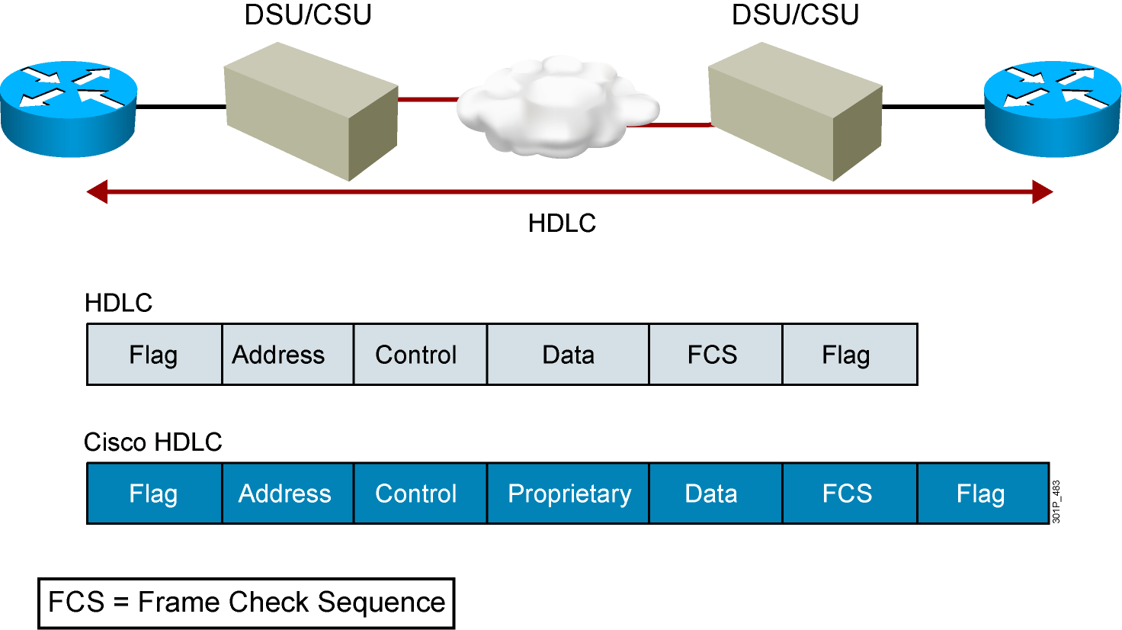
HDLC帧格式
只支持单协议环境
思科Proprietary数据域支持多协议环境

Slide 13
配置HDLC封装
RouterX(config-if)# encapsulation hdlc
启用HDLC封装；
HDLC是同步串口的缺省封装格式；

Slide 14
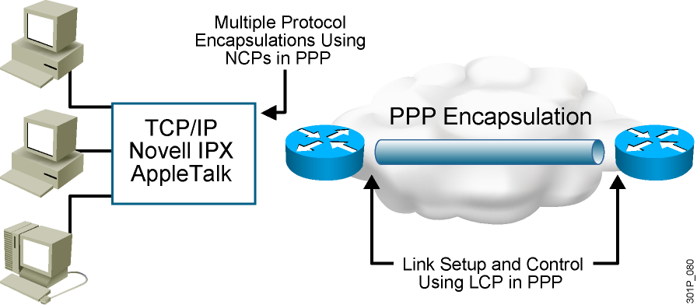
PPP简介
PPP 可以通过 NCP 携带多个协议的数据包；
PPP 可以通过 LCP 建立和控制连接；
Notes:
LCP链路控制协议：建立并维护数据链路连接。
NCP网络控制协议：允许在点到点连接上使用多种网络层协议（被动路由协议）
Purpose: This figure presents an overview of PPP.
Emphasize: The figure illustrates the multiple protocols that NCP supports.
The two arrows pointing to the router interfaces are where PPP encapsulation occurs.
The first bullet summarizes the role of NCP. The second bullet summarizes the role of the LCP options that the administrator can use to set up and control the data link.
Several RFCs are used to specify aspects of PPP. RFC 1548 is the major specification for the major PPP NCP and LCP operations.

Slide 15
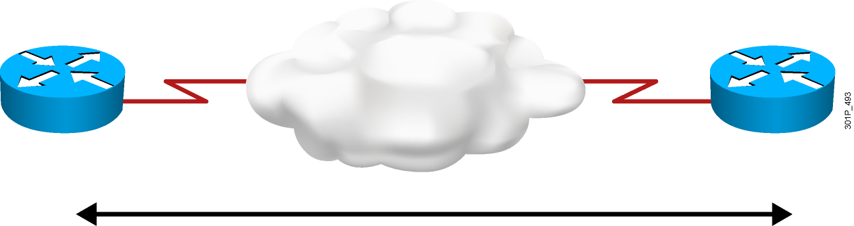
PPP会话的建立
  PPP会话建立:
  1. 链路建立阶段
  2. 认证阶段 (可选)
    两种PPP认证协议: PAP and CHAP
  3. 网络层协议阶段
Notes:
Purpose: This graphic presents the PPP authentication overview.
Emphasize: A PPP session establishment has three phases, as follows:
Link establishment phase—In this phase, each PPP device sends LCP packets to configure and test the data link.
Authentication phase (optional)—After the link has been established and the authentication protocol decided on, the peer may be authenticated.
PPP supports two authentication protocols: PAP and CHAP.
Both of these protocols are detailed in RFC 1334, PPP Authentication Protocols. However, RFC 1994, PPP Challenge Handshake Authentication Protocol, obsoletes RFC 1334.
Network-layer protocol phase—In this phase, the PPP devices send NCP packets to choose and configure one or more network-layer protocol.

Slide 16
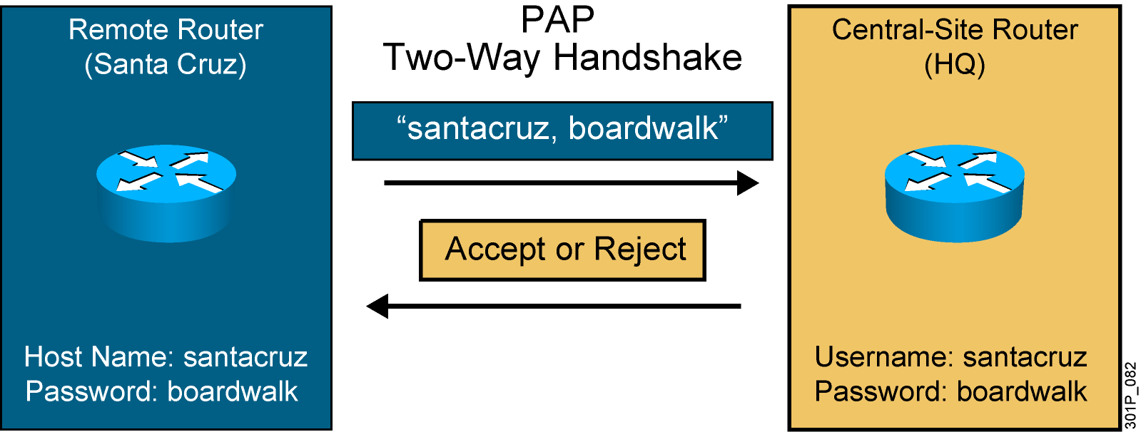
PPP认证协议: PAP(Password Authentication Protocol)
2次握手
密码发送的是明文
验证两端是同等
Notes:
PAP认证是被叫提出连接请求，主叫响应
Slide 1 of 2
Purpose: This figure presents the PPP authentication protocol, PAP.
Emphasize: PPP sets line controls for the call.
There are two types of authentication protocols: PAP and CHAP.
PAP provides a simple method for a remote node to establish its identity using a two-way handshake.
PAP is done only upon initial link establishment.
PAP is not a strong authentication protocol. It provides no encryption. It may be fine in DDR environments when the password changes each time a user authenticates.
CHAP is the preferred protocol.

Slide 17
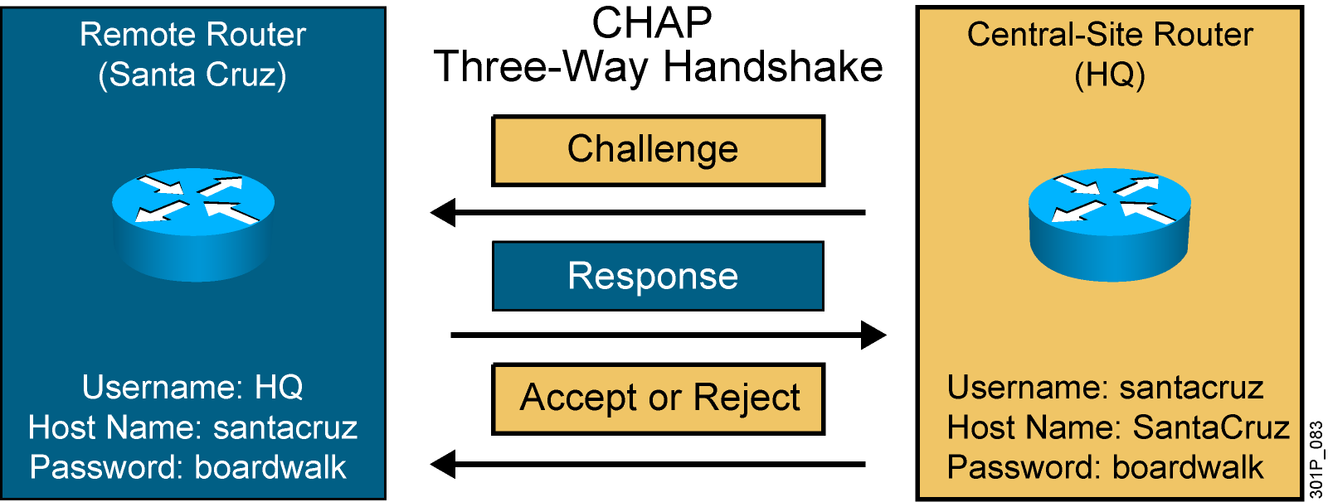
PPP认证协议: CHAP(Challenge Authentication Protocol)
三次握手
密码是加密的
Notes:
Slide 2 of 2
Purpose: This figure presents the PPP authentication protocol, CHAP.
Emphasize: CHAP is done upon initial link establishment and can be repeated any time after the link has been established.
CHAP transactions occur only when a link is established. The local access server does not request a password during the rest of the session. (The local access server can, however, respond to such requests from other devices during a session.)
CHAP is specified in RFC 1334. It is an additional authentication phase of the PPP Link Control Protocol.
Transition: Now that you know how PPP and PPP authentication operate, the following section describes how to configure these on a Cisco IOS router.

Slide 18
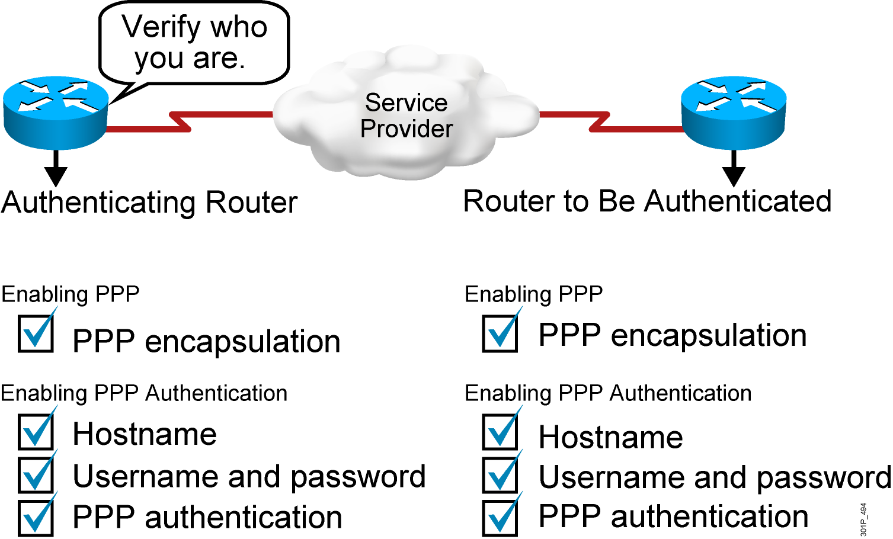
配置PPP和PPP认证
Notes:
Purpose: This figure provides a signpost highlighting the tasks you complete to enable PPP and PPP authentication.
Emphasize: Highlight the steps the student must take to enable PPP authentication.

Slide 19
配置PPP和PPP认证
RouterX(config-if)# encapsulation ppp
封装PPP
RouterX(config)# hostname name
指定路由器的名字
RouterX(config)# username name password password
标示远端路由的用户名和密码
RouterX(config-if)# ppp authentication {chap | chap pap |
pap chap | pap}
启用PAP或者CHAP认证
Notes:
Purpose: This figure describes how to encapsulate PPP on an interface.

Slide 20
PAP单向认证
使用PAP单向认证：（验证方R1—被验证方R2）
Router(config)#hostname R1
R1(config)#username R2 password cisco
R1(config)#int s1/0
R1(config-if)#encapsulation ppp
R1(config-if)#ppp authentication pap
Router(config)#hostname R2
R2(config)#int s1/0
R2(config-if)#encapsulation ppp
R2(config-if)#ppp pap sent-username R2 password 0 cisco
使用ping命令验证连通性。(注意，这里在R2上发送的用户名和密码必须和在R1上建立的用户名密码一致)

Slide 21
PAP双向认证
Router(config)#hostname R1 //设置主机名为R1
R1(config)#username R2 password cisco //建立用户R2，密码cisco
R1(config)#int s1/0
R1(config-if)#encapsulation ppp //用PPP封装
R1(config-if)#ppp authentication pap //PPP验证方式为pap
R1(config-if)#ppp pap sent-username R1 password 0 cisco
//发送用户名R1，密码cisco
Router(config)#hostname R2
R2(config)#username R1 password cisco
R2(config)#int s1/0
R2(config-if)#encapsulation ppp
R2(config-if)#ppp authentication pap
R2(config-if)#ppp pap sent-username R2 password 0 cisco
使用ping命令验证连通性。(注意，这里在R1上发送的用户名和密码必须和在R2上建立的用户名密码一致)

Slide 22
CHAP单向认证
（验证方R1—被验证方R2）
Router(config)#hostname R1
R1(config)#username R2 password cisco
R1(config)#int s1/0
R1(config-if)#encapsulation ppp
R1(config-if)#ppp authentication chap
Router(config)#hostname R2
R2(config)#int s1/0
R2(config-if)#encapsulation ppp
R2(config-if)#ppp chap hostname R2
R2(config-if)#ppp chap password 0 cisco

Slide 23
CHAP双向认证
Router(config)#hostname R1
R1(config)#username R2 password cisco
R1(config)#int s1/0
R1(config-if)#encapsulation ppp
R1(config-if)#ppp authentication chap
Router(config)#hostname R2
R2(config)#username R1 password cisco
R2(config)#int s1/0
R2(config-if)#encapsulation ppp
R2(config-if)#ppp authentication chap

Slide 24
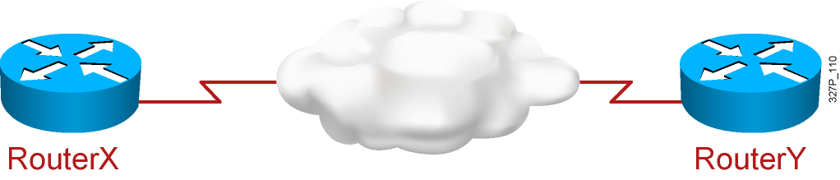
配置PPP CHAP认证实例
hostname RouterX
username RouterY password sameone
!
int serial 0
ip address 10.0.1.1 255.255.255.0
encapsulation ppp
ppp authentication chap
hostname RouterY
username RouterX password sameone
!
int serial 0
ip address 10.0.1.2 255.255.255.0
encapsulation ppp
ppp authentication chap
Notes:
Purpose: This page shows an example of CHAP configuration between two routers.
Emphasize: When you configure the usernames and passwords for the local databases, the passwords on both systems must be identical. Usernames and passwords are case sensitive.
Transition: The next section shows how to verify that the connection is operating as intended.

Slide 25
验证PPP封装配置
RouterX# show interface s0
Serial0 is up, line protocol is up
Hardware is HD64570
Internet address is 10.140.1.2/24
MTU 1500 bytes, BW 1544 Kbit, DLY 20000 usec, rely 255/255, load 1/255
Encapsulation PPP, loopback not set, keepalive set (10 sec)
LCP Open
Open: IPCP, CDPCP
Last input 00:00:05, output 00:00:05, output hang never
Last clearing of "show interface" counters never
Queueing strategy: fifo
Output queue 0/40, 0 drops; input queue 0/75, 0 drops
5 minute input rate 0 bits/sec, 0 packets/sec
5 minute output rate 0 bits/sec, 0 packets/sec
38021 packets input, 5656110 bytes, 0 no buffer
Received 23488 broadcasts, 0 runts, 0 giants, 0 throttles
0 input errors, 0 CRC, 0 frame, 0 overrun, 0 ignored, 0 abort
38097 packets output, 2135697 bytes, 0 underruns
0 output errors, 0 collisions, 6045 interface resets
0 output buffer failures, 0 output buffers swapped out
482 carrier transitions
DCD=up DSR=up DTR=up RTS=up CTS=up
Notes:
240 197 102
对IP的PPP网络控制协议
Cisco Discovery Protocol Control Protocol 应该是思科设备的发现协议

Slide 26
验证PPP认证
RouterX# debug ppp authentication
4d20h: %LINK-3-UPDOWN: Interface Serial0, changed state to up
4d20h: Se0 PPP: Treating connection as a dedicated line
4d20h: Se0 PPP: Phase is AUTHENTICATING, by both
4d20h: Se0 CHAP: O CHALLENGE id 2 len 28 from ”left"
4d20h: Se0 CHAP: I CHALLENGE id 3 len 28 from ”right"
4d20h: Se0 CHAP: O RESPONSE id 3 len 28 from ”left"
4d20h: Se0 CHAP: I RESPONSE id 2 len 28 from ”right"
4d20h: Se0 CHAP: O SUCCESS id 2 len 4
4d20h: Se0 CHAP: I SUCCESS id 3 len 4
4d20h: %LINEPROTO-5-UPDOWN: Line protocol on Interface Serial0, changed state to up
采用debug ppp authentication命令显示CHAP的信息输出
Notes:
PPP的阶段验证，both
Purpose: This page shows an example of debug ppp authentication output. The output illustrates a successful CHAP authentication challenge.
Emphasize: The debug ppp authentication command displays the authentication exchange sequence as it occurs.

Slide 27
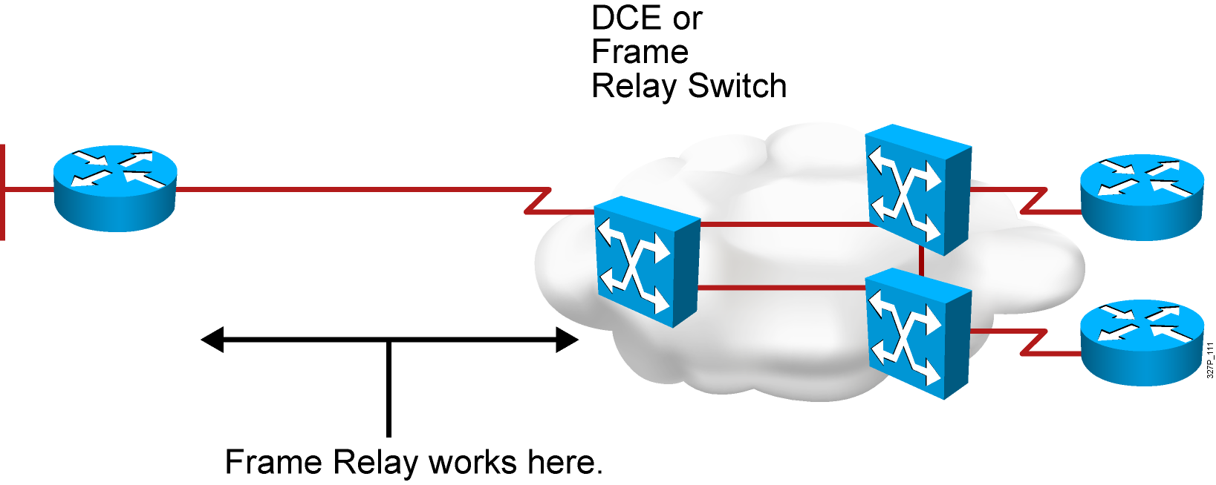
帧中继(Frame Relay)简介
使用虚电路进行连接；
提供面向对象的服务
Notes:
Purpose: This figure provides a big-picture definition of Frame Relay.
Emphasize: Frame Relay is used between the CPE device and the Frame Relay switch. It does NOT affect how packets get routed within the Frame Relay cloud.
Frame Relay is a purely Layer 2 protocol.
The network providing the Frame Relay service can be either a carrier-provided public network or a network of privately owned equipment serving a single enterprise.
Make a clear distinction between DCE, DTE, and CPE.
Emphasize that Frame Relay over SVCs is not discussed in this chapter because it is not widely supported by service providers at this time. The service provider must also support SVCs in order for Frame Relay over SVCs to operate.
Note: In Cisco IOS Release 11.2, two traffic shaping features were introduced:
Generic (adaptive) traffic shaping
Frame Relay traffic shaping
Both of these features can be used to adjust the rate at which traffic is sent by the router. In addition, these features allow the router to throttle the traffic rate based on BECNs received from the Frame Relay switch. Neither of these features are discussed in this course. Frame Relay traffic shaping is discussed in the Building Cisco Remote Access Networks (BCRAN) course. Information on both can be found in Cisco documentation.

Slide 28
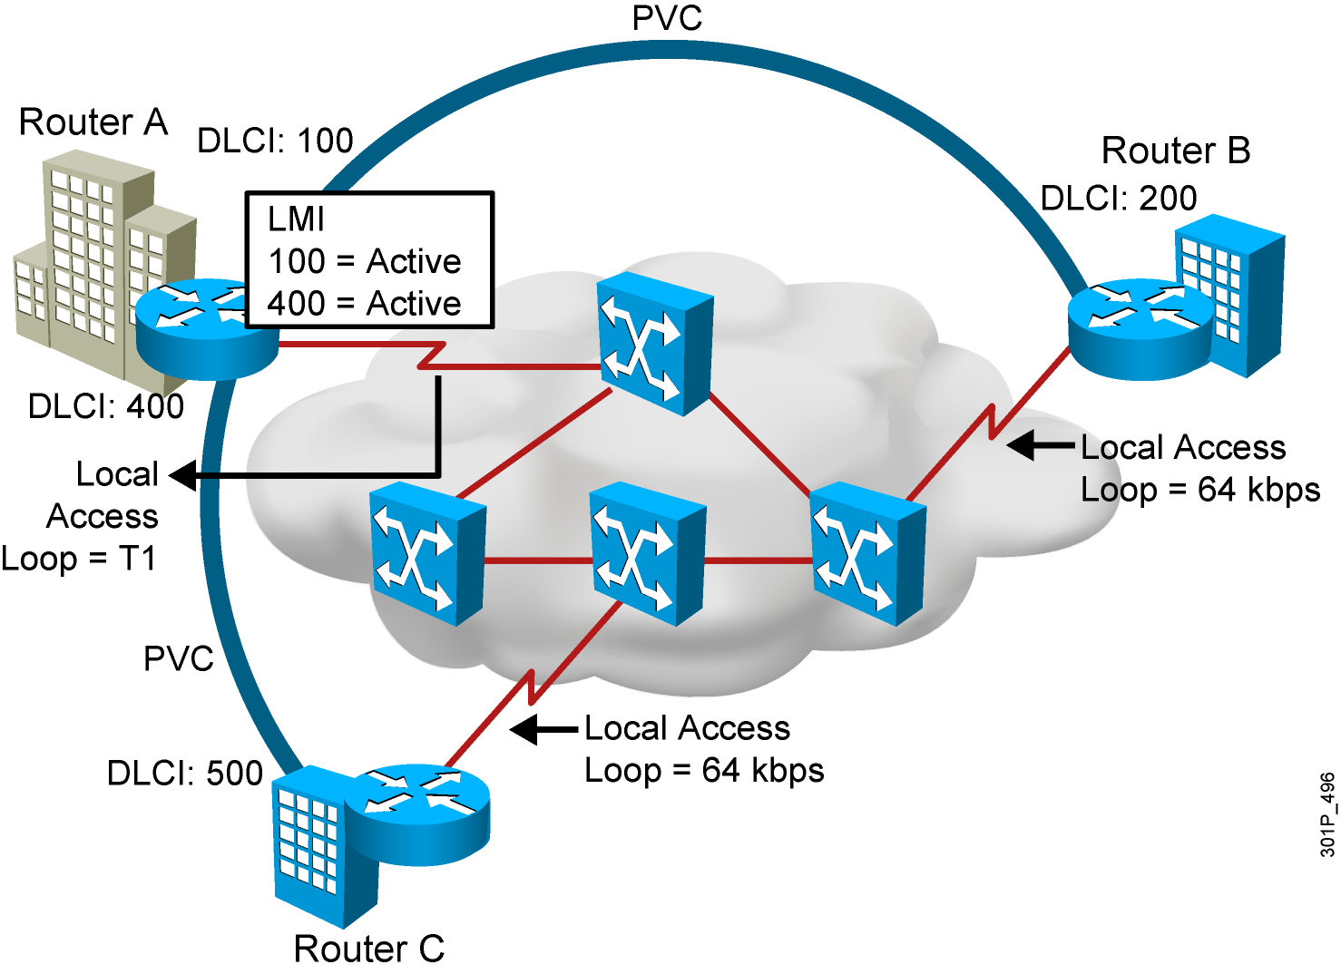
Frame Relay术语
术语1：虚电路：
1、两个 DTE 之间通过帧中继网络实现的连接叫做虚电路 (VC)。
2、利用虚电路，帧中继允许多个用户共享带宽，而无需使用多条专用物理线路，虚电路是以 DLCI 标识的。
3、DLCI 值通常由帧中继服务提供商（例如电话公司）分配。
4、帧中继 DLCI 仅具有本地意义
5、DLCI 0 到 15 和 1008 到 1023 留作特殊用途。
6、服务提供商分配的 DLCI 范围通常为 16 到 1007。
Notes:
Purpose: This figure provides an overview of terminology so that the student is prepared to understand the Frame Relay operation discussion.
The terminology used with Frame Relay varies by service provider. These are the commonly used terms.
Point out the local access loop and note that the local access rate is different than the rate used within the Frame Relay cloud.
The DLCI is of local significance, therefore, point out that the same DLCI can be used in multiple places in the network.
The autosensing LMI is a Release 11.2 or later feature.
Frame Relay connections are made using PVCs. The circuits are identified by the DLCI assigned by the service provider.
Reference: For more information on Frame Relay, including a Frame Relay glossary, refer to the Frame Relay Forum World Wide Web page:
http://www.frforum.com/4000/4003.html
This course does not discuss Frame Relay traffic flow issues. Terms like BECN, FECN, and discard eligible are not discussed in this course. These terms are some of the terms that can be found in the Frame Relay Forum’s glossary. The BCRAN discusses Frame Relay traffic flow issues.

Slide 29
Frame Relay术语
术语2： LMI(本地管理接口)
1、LMI 是一种 keepalive（保持连接）的机制，提供路由器 (DTE) 和帧中继交换机 (DCE) 之间的帧中继连接的状态信息。终端设备每 10 秒（或大概如此）轮询一次网络。
2、Cisco 路由器支持以下三种 LMI： Cisco Ansi q933a
配置命令如下： frame-relay lmi-type [cisco | ansi | q933a]
3、路由器从帧中继交换机的帧封装接口接受LMI信息，并将虚链路状态更新为下列3种状态之一：
Active state:正常状态
Inactive state:远程路由器没有工作
Deleted state:接口没有收到交换机的任何LMI信息，可能是映射问题或者线路问题
Local Access Loop:本地接入回环
Notes:
Purpose: This figure provides an overview of terminology so that the student is prepared to understand the Frame Relay operation discussion.
The terminology used with Frame Relay varies by service provider. These are the commonly used terms.
Point out the local access loop and note that the local access rate is different than the rate used within the Frame Relay cloud.
The DLCI is of local significance, therefore, point out that the same DLCI can be used in multiple places in the network.
The autosensing LMI is a Release 11.2 or later feature.
Frame Relay connections are made using PVCs. The circuits are identified by the DLCI assigned by the service provider.
Reference: For more information on Frame Relay, including a Frame Relay glossary, refer to the Frame Relay Forum World Wide Web page:
http://www.frforum.com/4000/4003.html
This course does not discuss Frame Relay traffic flow issues. Terms like BECN, FECN, and discard eligible are not discussed in this course. These terms are some of the terms that can be found in the Frame Relay Forum’s glossary. The BCRAN discusses Frame Relay traffic flow issues.

Slide 30
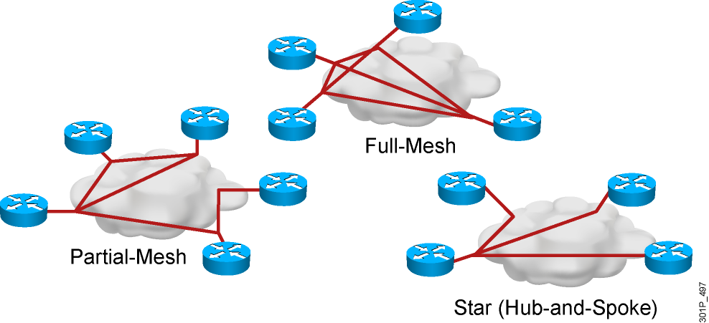
选择帧中继拓扑
帧中继默认: NBMA
Notes:
Purpose: This figure is a transition discussion to illustrate the need for subinterfaces. Now that students are familiar with the concept and configuring of Frame Relay, they are ready to consider the issues and solutions related to broadcast updates in an NBMA Frame Relay network.
Emphasize: Compare the different topologies described.
Explain that by default, interfaces that support Frame Relay are multipoint connection types. This type of connection is not a problem when only one PVC is supported by a single interface; but it is a problem when multiple PVCs are supported by a single interface. In this situation, broadcast routing updates received by the central router cannot be broadcast to the other remote sites.
Broadcast routing updates are issued by distance vector protocols. Link-state and hybrid protocols use multicast and unicast addresses.

Slide 31
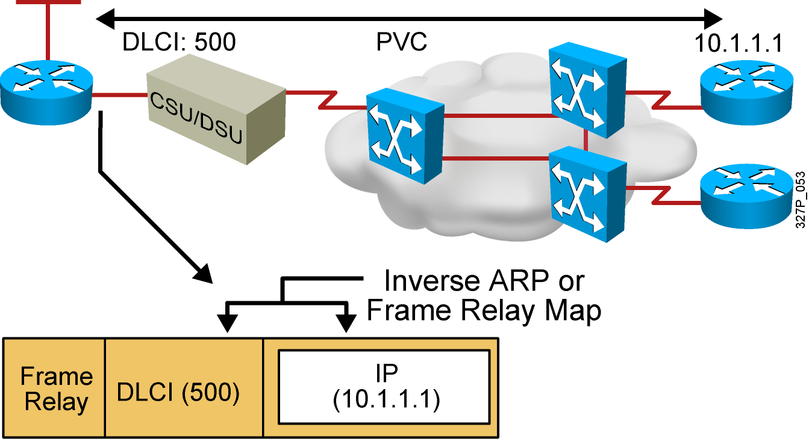
帧中继(Frame Relay)地址映射
从提供商那里得到本地的DLCI号 ；
建立目的地址和本地DLCI之间的映射关系
Notes:
Purpose: This figure illustrates mapping the data-link connection identifier (DLCI) to the network-layer address such as IP.
Emphasize: The DLCI is of local significance, therefore, point out that the same DLCI can be used in multiple places in the network. Frame Relay connections are made using PVCs. The circuits are identified by the DLCI assigned by the service provider.
Explain what Inverse ARP is used for. Static mapping can be configured instead of Inverse ARP.

Slide 32
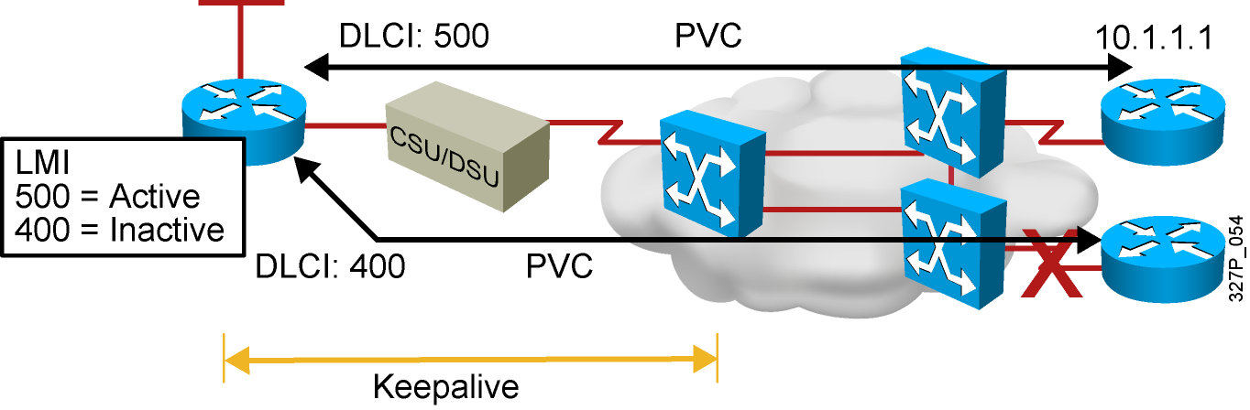
帧中继(Frame Relay)信号
Cisco支持三种LMI类型:
  Cisco
  ANSI T1.617 Annex D
  ITU-T Q.933 Annex A
Notes:
Purpose: This figure describes the Local Management Interface (LMI) and shows the key standards.
Emphasize: Explain LMI.
Note: Other key American National Standards Institute (ANSI) standards are T1.606, which defines the Frame Relay architecture, and T1.618, which describes data transfer.
Other key International Telecommunication Union Telecommunication Standardization Sector (ITU-T) specifications include I.122, which defines ITU-T Frame Relay architecture, and Q.922, which standardizes data transfer. Use of these LMI standards is especially widespread in Europe.
The original “gang of four” no longer exists; StrataCom® merged with Cisco, and Digital Equipment Corporation was acquired by Compaq Computers.

Slide 33
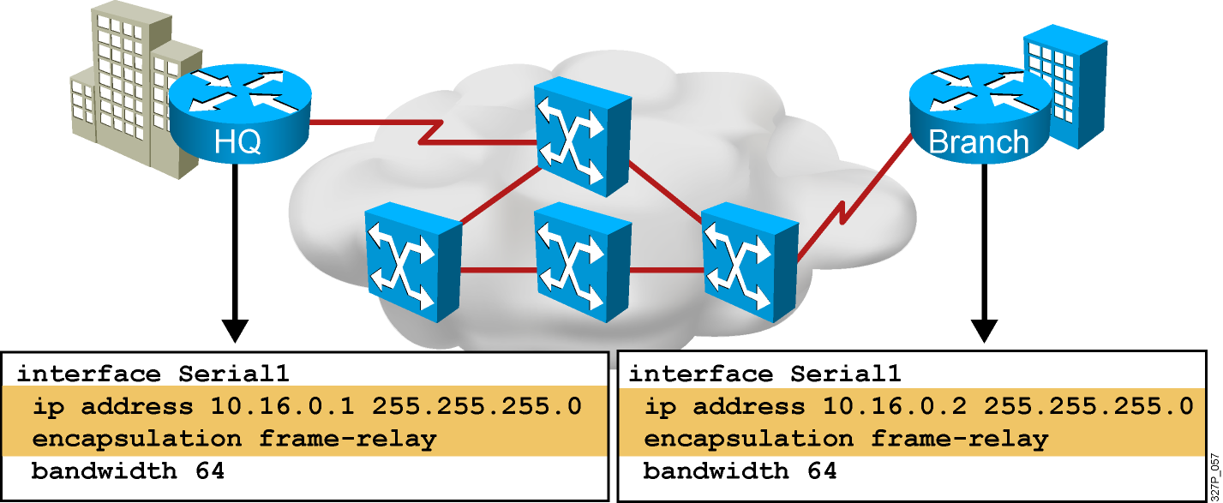
配置基本的帧中继(Frame Relay)
Notes:
Slide 1 of 2:
Purpose: This figure introduces basic Frame Relay configuration over a physical interface. It is important that students understand how configuration occurs in order for them to understand the subinterfaces discussion later in the chapter.
These steps assume that LMI and Inverse ARP are supported, therefore no static maps are needed.
Regarding Step 3:
Cisco’s Frame Relay encapsulation uses a 4-byte header, with 2 bytes to identify the DLCI and 2 bytes to identify the packet type.
Use the ietf encapsulation command to connect to other vendors. The IETF standard is defined in RFCs 1294 and 1490.
Regarding Step 4:
The LMI connection is established by the frame-relay lmi-type [ansi | cisco | q933a] command. The default values established during initial setup are usually sufficient to maintain connectivity with the Frame Relay network. Altering these values would only be required in case of intermittent failures. Changing the default values of the LMI should only be attempted after consulting with your service provider.
These configuration steps are the same, regardless of the network-layer protocols operating across the network.

Slide 34
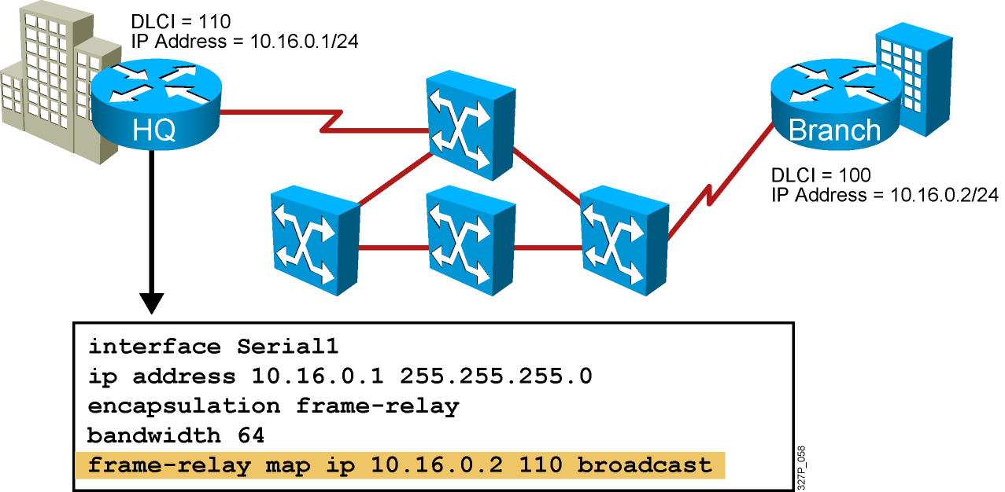
配置静态的帧中继(Frame Relay)映射
什么时候需要配置静态帧中继映射:
  帧中继对端不支持反向ARP( Inverse ARP)；
  你想在PVC上控制广播流量；
  你想在 PVCs上有不同的帧中继封装；
Notes:
Purpose: This figure discusses the static map command option:
Emphasize: You can use the frame-relay map command to configure multiple DLCIs to be multiplexed over one physical link. Instead of using Inverse ARP, the Frame Relay map tells the Cisco IOS software how to get from a specific protocol and address pair to the correct DLCI.
Point out that this command is similar to building a static route.
The simplest way to generate a static map is to let the router learn the information dynamically first. Some users let the router learn the information dynamically, then enable static maps for easier network administration.
These configuration steps are the same, regardless of the network-layer protocols operating across the network.
Although static maps are not needed when Inverse ARP is enabled, it is a good idea to configure them for each connection for easier network administration.

Slide 35
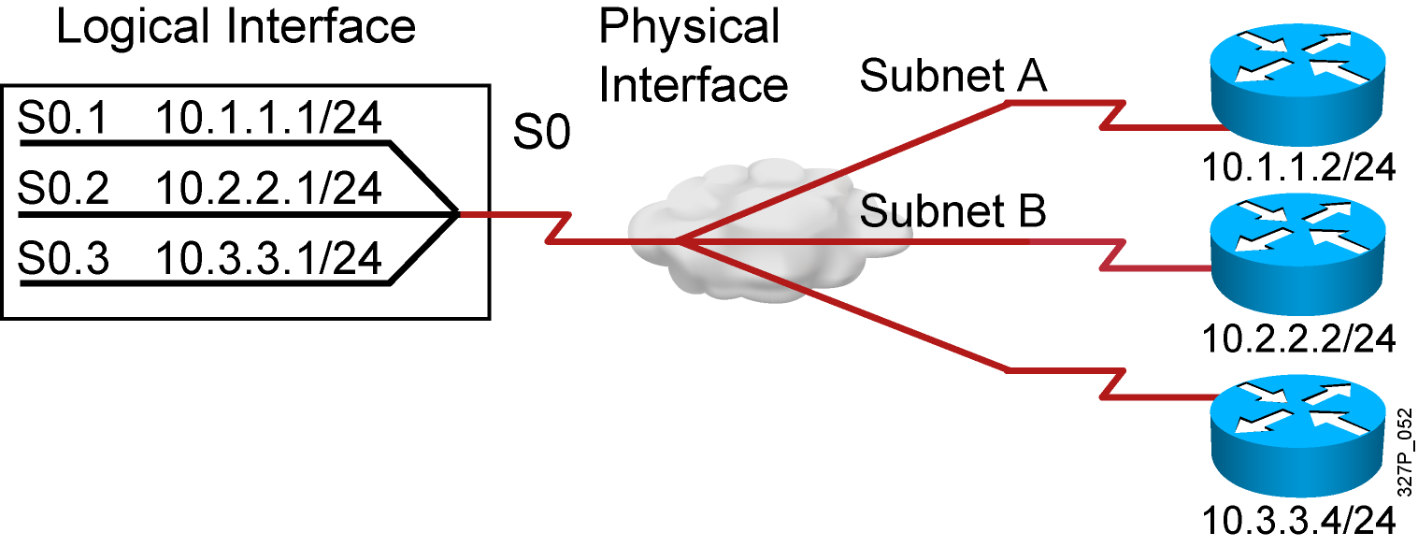
实现路由信息的可达性
解决方法:
  1. 在NBMA环境的网络中使用水平分割可能造成一些问题
  2. 划分子接口可以解决水平分割造成的问题
  3. 一个物理接口可以被划分成多个逻辑意义上的子接口
Notes:
Purpose: This figure defines subinterfaces and how they can resolve NBMA issues.
Emphasize: You can have connectivity problems in a Frame Relay network if the following conditions exist:
You are using an NBMA model.
Your configuration is in a partial mesh.
You are using a distance vector routing protocol.
Split-horizon is enabled on the routing protocol.
If the routing protocol is configured with split-horizon, routing updates from one router connected on the multipoint subinterface are not propagated to other routers connected on this multipoint subinterface. For example, if router C sends a routing update, this split horizon will keep this update from being sent back out the subinterface to router D.
To resolve this problem you can do the following:
Use Frame Relay subinterfaces to overcome the split-horizon problem.
Use a routing protocol that supports disabling split-horizon.
Use this configuration if you want to save IP address space.
You can also use this type of configuration with several fully meshed groups. Routing updates will be exchanged between the fully meshed routers.
Note: When an interface is assigned “encapsulation frame-relay,” split horizon is disabled for IP and enabled for IPX and AppleTalk, by default.

Slide 36
配置帧中继(Frame Relay)子接口
点对点子接口
    点对点子接口看作是专线;
    每一个点对点连接的子接口要求由自己的子网;
    适用于星型拓扑结构;
多点子接口
    多点子接口应用在 NBMA 网络，因此它们无法解决水平分割所带来的问题;
    由于使用的是单独的子网可以保存地址空间;
    适用于 Partial-Mesh 和 Full-Mesh 拓扑结构中;
Notes:
Purpose: This figure begins the discussion on configuring subinterfaces.
Emphasize: The encapsulation frame-relay command is assigned to the physical interface. All other configuration items, such as the network-layer address and DLCIs, are assigned to the subinterface.
Multipoint may not save you addresses if you are using VLSMs. Further, it may not work properly given the broadcast traffic and split-horizon considerations. The point-to-point subinterface option was created to avoid these issues.
Note: Subinterfaces are also used with ATM networks and IPX LAN environments where multiple encapsulations exist on the same medium.

Slide 37
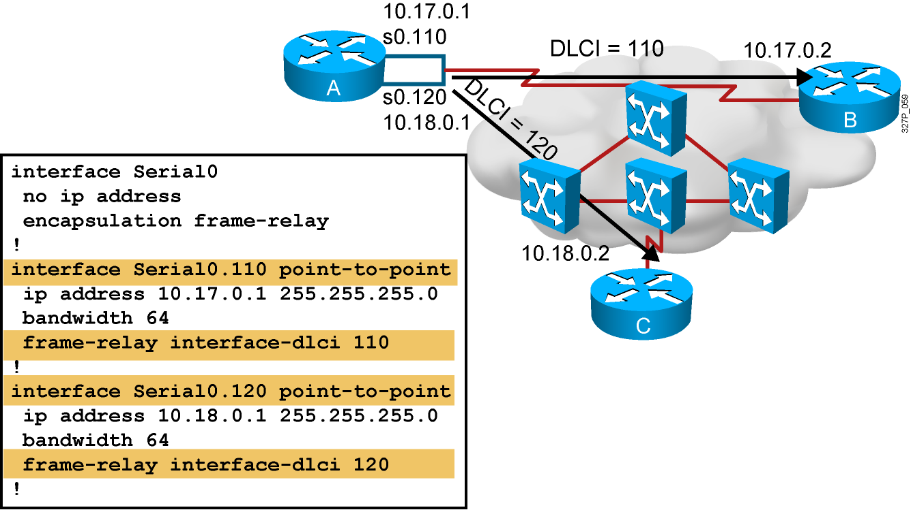
配置帧中继(Frame Relay)Point-to-Point 子接口
Notes:
Purpose: This figure continues the discussion of configuring subinterfaces.
Emphasize: The Frame Relay service provider will assign the DLCI numbers. These numbers range from 16 to 992. This range will vary depending on the LMI used.
Use the frame-relay interface-dlci command on subinterfaces only. Use of the command on an interface, rather than a subinterface, will prevent the device from forwarding packets intended for the DLCI. It is also required for multipoint subinterfaces for which dynamic address resolution is enabled. It is not used for multipoint subinterfaces configured with the frame-relay map command for static address mapping.
Using the frame-relay interface-dlci command with subinterfaces provides greater flexibility when configuring Frame Relay networks.
On multipoint subinterfaces, the frame-relay interface-dlci command enables Inverse ARP on the subinterface. When this command is used with point-to-point subinterfaces, all traffic for the subinterface’s subnetwork are sent out this subinterface.
The ability to change a subinterface from point-to-point to multipoint, or vice versa, is limited by the software architecture. The router must be rebooted for a change of this type to take effect. An alternative exists to rebooting the router and creating a network outage. Create another subinterface in the software and migrate the configuration parameters to the new subinterface using the proper point-to-point or multipoint setting, as required.

Slide 38
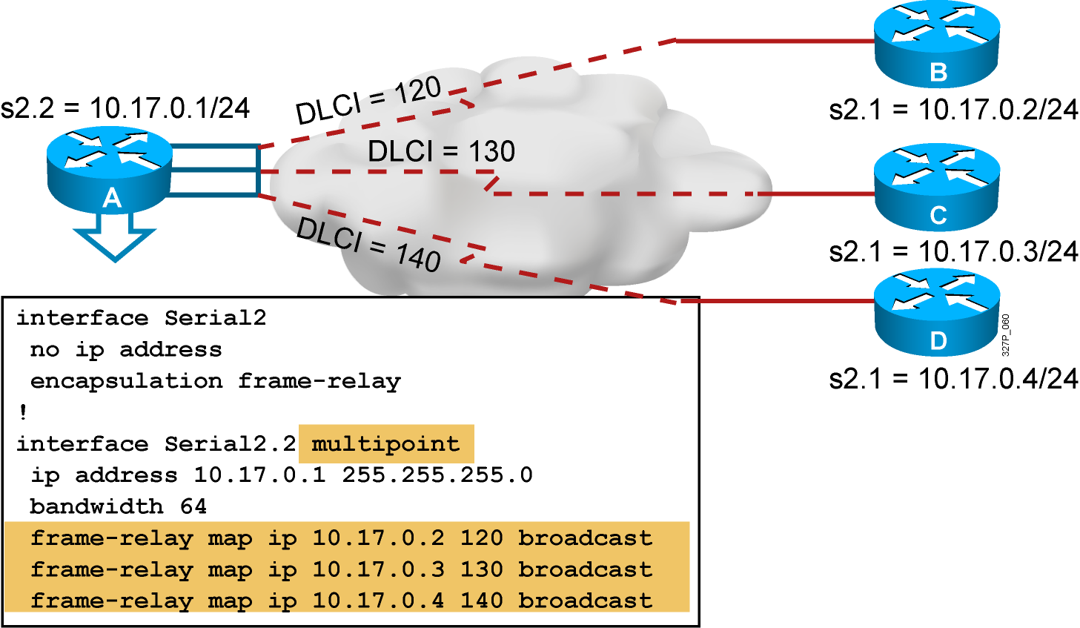
配置帧中继(Frame Relay)Multipoint子接口
Notes:
Purpose: This graphic illustrates a multipoint subinterface example.
Emphasize: In this example, the subinterface is configured to behave as a normal NBMA Frame Relay interface.
No IP address is configured on the physical interface. It is important that the physical interface NOT have an address, otherwise routing will not work.
The frame-relay map command is used to create the multiple PVC connections from a single interface.
All connections are in the same subnet.
The DLCIs are provided by your service provider.

Slide 39
查看帧中继(Frame Relay)的操作
RouterX# show interfaces type number
显示关于帧中继DLCIs和LMI的相关信息
RouterX# show interfaces s0
Serial0 is up, line protocol is up
Hardware is HD64570
Internet address is 10.140.1.2/24
MTU 1500 bytes, BW 1544 Kbit, DLY 20000 usec, rely 255/255, load 1/255
Encapsulation FRAME-RELAY, loopback not set, keepalive set (10 sec)
LMI enq sent 19, LMI stat recvd 20, LMI upd recvd 0, DTE LMI up
LMI enq recvd 0, LMI stat sent 0, LMI upd sent 0
LMI DLCI 1023 LMI type is CISCO frame relay DTE
FR SVC disabled, LAPF state down
Broadcast queue 0/64, broadcasts sent/dropped 8/0, interface broadcasts 5
Last input 00:00:02, output 00:00:02, output hang never
Last clearing of "show interface" counters never
Queueing strategy: fifo
Output queue 0/40, 0 drops; input queue 0/75, 0 drops
<Output omitted>
Notes:
LMI DLCI，缺省是1023， 类型是cisco，如果LMI DLCI为0，它将使用ANSI LMI类型
Slide 1 of 6
Purpose: This figure shows how the show interface command is used to verify whether Frame Relay operation and router connectivity to remote routers are working.
Emphasize: Describe the highlighted output to the students.

Slide 40
查看帧中继(Frame Relay)的操作
RouterX# show frame-relay lmi [type number]
显示LMI的统计信息
RouterX# show frame-relay lmi
LMI Statistics for interface Serial0 (Frame Relay DTE) LMI TYPE = CISCO
Invalid Unnumbered info 0 Invalid Prot Disc 0
Invalid dummy Call Ref 0 Invalid Msg Type 0
Invalid Status Message 0 Invalid Lock Shift 0
Invalid Information ID 0 Invalid Report IE Len 0
Invalid Report Request 0 Invalid Keep IE Len 0
Num Status Enq. Sent 113100 Num Status msgs Rcvd 113100
Num Update Status Rcvd 0 Num Status Timeouts 0
Notes:
Slide 2 of 6
Purpose: This figure shows how the show frame-relay LMI command is used to verify the LMI type used for signaling.
Emphasize: Describe the highlighted output to the students.

Slide 41
查看帧中继(Frame Relay)的操作
RouterX# show frame-relay pvc [type number [dlci]]
显示PVC的统计信息
RouterX# show frame-relay pvc 100
PVC Statistics for interface Serial0 (Frame Relay DTE)
DLCI = 100, DLCI USAGE = LOCAL, PVC STATUS = ACTIVE, INTERFACE = Serial0
input pkts 28 output pkts 10 in bytes 8398
out bytes 1198 dropped pkts 0 in FECN pkts 0
in BECN pkts 0 out FECN pkts 0 out BECN pkts 0
in DE pkts 0 out DE pkts 0
out bcast pkts 10 out bcast bytes 1198
pvc create time 00:03:46, last time pvc status changed 00:03:47
Notes:
Slide 3 of 6
Purpose: This figure shows how the show frame-relay pvc command is used to verify whether Frame Relay operation and router connectivity to remote routers are working.
Emphasize: Describe the highlighted output to the students.

Slide 42
查看帧中继(Frame Relay)的操作
RouterX# show frame-relay map
显示目前帧中继的映射条目
RouterX# clear frame-relay-inarp
清除通过Inverse ARP产生的帧中继映射
RouterX# show frame-relay map
Serial0 (up): ip 10.140.1.1 dlci 100(0x64,0x1840), dynamic,
broadcast,, status defined, active
RouterX# clear frame-relay-inarp
RouterX# show frame map
RouterX#
Notes:
Slide 4 of 6
Purpose: This figure shows how the show frame-relay map command is used to verify that Frame Relay has a map entry in the Frame Relay map table.
Emphasize: Describe the highlighted output to the students.

